Slide 1



Advance Database Management System
Prof. Alka Choksi, Assistant Professor
Parul Institute Of Computer Application.

Slide 2
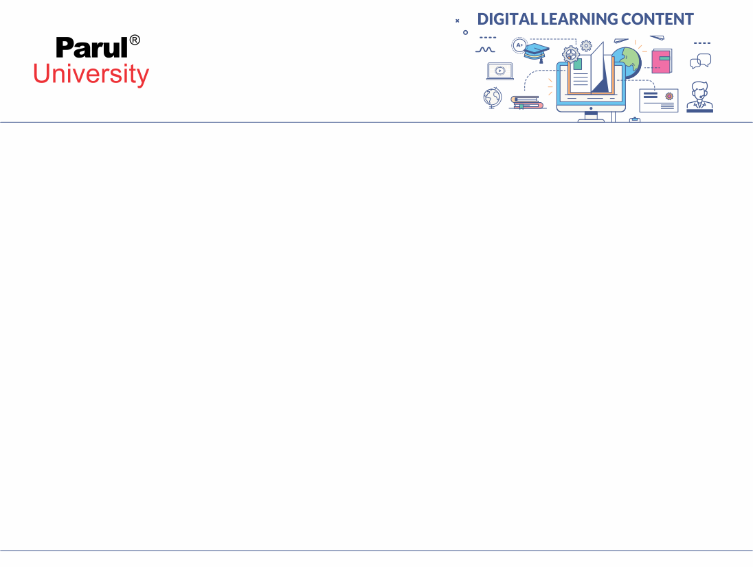

CHAPTER-1
Introduction To Databases

Slide 3
What is Data?
Data is collection of raw facts and unprocessed .
Data can be any character, text, words, number, pictures, sound, or video.
Data has no value until it is used.
Data can be stored in pieces of paper or electronic memory, etc.
Data can be stored easily, and at a low cost.
Data becomes information when it is processed.
e.g based on the cookie data saved on user's browser, if a website can analyse that generally men of age 20-25 visit us more, that is information, derived from the data collected.

Slide 4
What is Database?
A Database is a collection of related data organized in a way that data can be easily accessed, managed and updated. Database can be software based or hardware based, with one sole purpose, storing data.
For example: The college Database organizes the data about the admin, staff, students and faculty etc.
Using the database, you can easily retrieve, insert, and delete the information.
Database is a collection of related data and data is a collection of facts and figures that can be processed to produce information.
Examples:
phone book
address book
Mobile contacts

Slide 5
Database Management System
.
A DBMS serves as an interface between the database and its end users or programs, allowing users to retrieve, update, and manage how the information is organized and optimized. A DBMS also facilitates oversight and control of databases, enabling a variety of administrative operations such as performance monitoring, tuning, and backup and recovery.
DBMS also provides protection and security to the databases.
It also maintains data consistency in case of multiple users.
Some examples of popular database software or DBMSs include MySQL, Microsoft Access, Microsoft SQL Server, FileMaker Pro, Oracle Database, and dBASE, IBM DB2 ,PostgreSQL ,Amazon Simple DB (cloud based) etc.

Slide 6
Benefits of DBMS
Reducing Data Redundancy
The file based data management systems contained multiple files that were stored in many different computer system locations in a system or even across multiple systems. Because of this, there were sometimes multiple copies of the same file which lead to lots of data redundancy.
This is prevented in a database as there is a single database and any change in it reflected immediately. Because of this, there is no chance of encountering duplicate data in it.
E.g. Saving the same file five times to five different disks e.g. Your dictionary.

Slide 7
Benefits of DBMS
Sharing of Data
In a database, the users of the database can share the data among themselves. There are various levels of authorization to access the data, and consequently the data can only be shared based on the correct authorization protocols being followed.
Many remote users can also access the database simultaneously and share the data between themselves.
Data Security
Data Security is vital concept in a database. Only authorized users should be allowed to the access the database and their identity should be authenticated using a username and password. Unauthorized users should not allowed to access the database under any circumstances as it violates the integrity constraints.

Slide 8
Benefits of DBMS
Data Integrity
Data integrity means that the data is accurate and consistent in the database. Data Integrity is very important as there are multiple databases in a DBMS. All of these databases contain data that is visible to multiple users. So it is necessary to ensure that the data is correct and consistent in all the databases and for all the users.
Privacy
The privacy rule in a database means only the authorized users can access a data in database according to its privacy constraints. There are levels of database access and a user can only view the data he is allowed to view. For example - In social networking sites, access constraints are different for different accounts a user may want to access account.

Slide 9
Benefits of DBMS
Backup and Recovery
DBMS automatically takes care of backup and recovery. The users don't need to backup data periodically because this is taken care of by the database management system. Moreover, it also restores the database after a crash or system failure to its previous condition of it.
Data Consistency
data consistency is ensured in a database because there is no data redundancy. All data appears consistently across the database and the data is same for all the users viewing the database. Moreover, any changes made to the database are immediately reflected to all the users and there is no data inconsistency.

Slide 10
Data Model
Data model defines the logical design and structure of a database and defines how data will be stored, accessed and updated in a database management system.
Data Models are fundamental entities to introduce abstraction in a DBMS.
The very first data model could be flat data-models, where all the data used are to be kept in the same plane. Earlier data models were not so scientific, hence they were prone to introduce lots of duplication and update anomalies.
Hierarchical Model
Network Model
Entity-Relationship Model
Relational Model
Object-Oriented Data Model

Slide 11
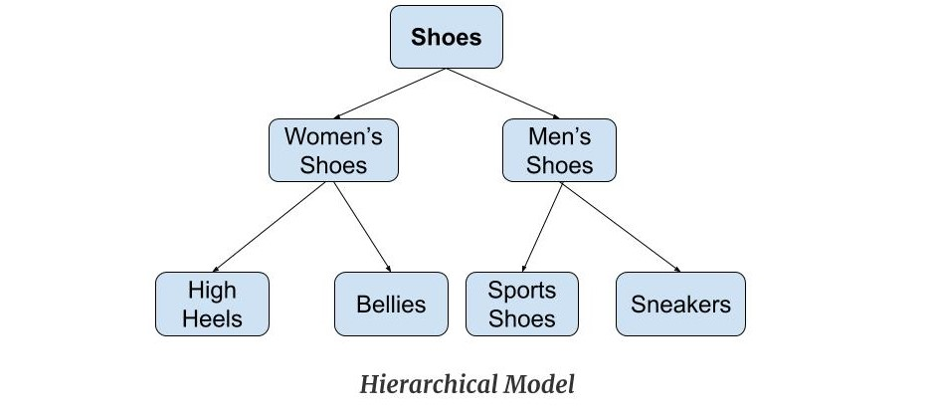
Hierarchical Model
Hierarchical Model was the first DBMS model. This model organizes the data in the hierarchical tree structure. The hierarchy starts from the root which has root data and then it expands in the form of a tree adding child node to the parent node. This model easily represents some of the real-world relationships like food recipes, sitemap of a website etc.

Slide 12
Advantages of Hierarchical Model
It is very simple and fast to traverse through a tree-like structure.
Any change in the parent node is automatically reflected in the child node so, the integrity of data is maintained.
Disadvantages of Hierarchical Model
Complex relationships are not supported.
As it does not support more than one parent of the child node so if we have some complex relationship where a child node needs to have two parent node then that can't be represented using this model.
If a parent node is deleted then the child node is automatically deleted.

Slide 13
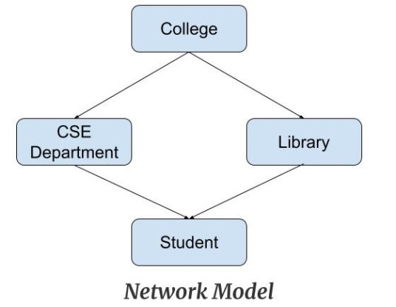
Network Model
This model is an extension of the hierarchical model. It was the most popular model before the relational model. This model is the same as the hierarchical model, the only difference is that a record can have more than one parent. It replaces the hierarchical tree with a graph. Example: In the example below we can see that node student has two parents i.e. CSE Department and Library. This was earlier not possible in the hierarchical model.

Slide 14
Advantages of Network Model
The data can be accessed faster as compared to the hierarchical model. This is because the data is more related in the network model and there can be more than one path to reach a particular node. So the data can be accessed in many ways.
As there is a parent-child relationship so data integrity is present. Any change in parent record is reflected in the child record.
Disadvantages of Network Model
As more and more relationships need to be handled the system might get complex. So, a user must be having detailed knowledge of the model to work with the model.
Any change like updating, deletion, insertion is very complex.

Slide 15
Entity-Relationship Diagram
Entity-Relationship (ER) Model is based on the notion of real-world entities and relationships among them. While formulating real-world scenario into the database model, the ER Model creates entity set, relationship set, general attributes and constraints.
ER Model is best used for the conceptual design of a database.
ER Model is based on −
Entities and their attributes.
Relationships among entities.

Slide 16
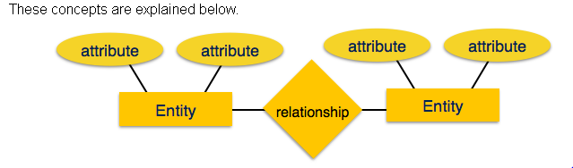
Entity − An entity in an ER Model is a real-world entity having properties called attributes. Every attribute is defined by its set of values called domain. For example, in a school database, a student is considered as an entity. Student has various attributes like name, age, class, etc.
Relationship − The logical association among entities is called relationship. Relationships are mapped with entities in various ways. Mapping cardinalities define the number of association between two entities.
Mapping cardinalities −
one to one
one to many
many to one
many to many

Slide 17
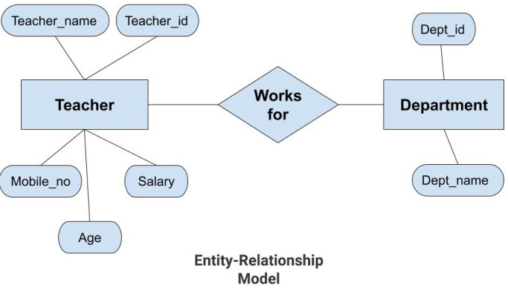

Slide 18
Advantages of ER Model
Simple: Conceptually ER Model is very easy to build. If we know the relationship between the attributes and the entities we can easily build the ER Diagram for the model.
Effective Communication Tool: This model is used widely by the database designers for communicating their ideas.
Easy Conversion to any Model: This model maps well to the relational model and can be easily converted relational model by converting the ER model to the table. This model can also be converted to any other model like network model, hierarchical model etc.
Disadvantages of ER Model
No industry standard for notation: There is no industry standard for developing an ER model. So one developer might use notations which are not understood by other developers.
Hidden information: Some information might be lost or hidden in the ER model. As it is a high-level view so there are chances that some details of information might be hidden.

Slide 19
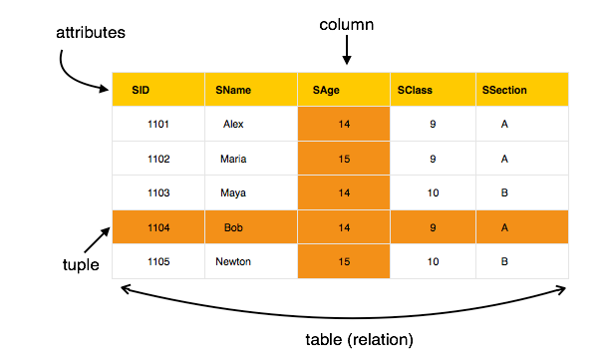
Relational Model
The most popular data model in DBMS is the Relational Model. It is more scientific a model than others. This model is based on first-order predicate logic and defines a table as an n-ary relation.

Slide 20
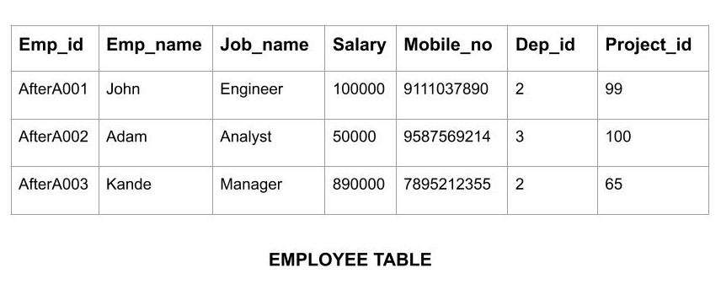
Relational Model
The main highlights of this model are −
Data is stored in tables called relations.
Relations can be normalized.
In normalized relations, values saved are atomic values.
Each row in a relation contains a unique value.
Each column in a relation contains values from a same domain.

Slide 21
Relational Model
In this model, data is organised in two-dimesional tables called relations. The tables or relation are related to each other.

Slide 22
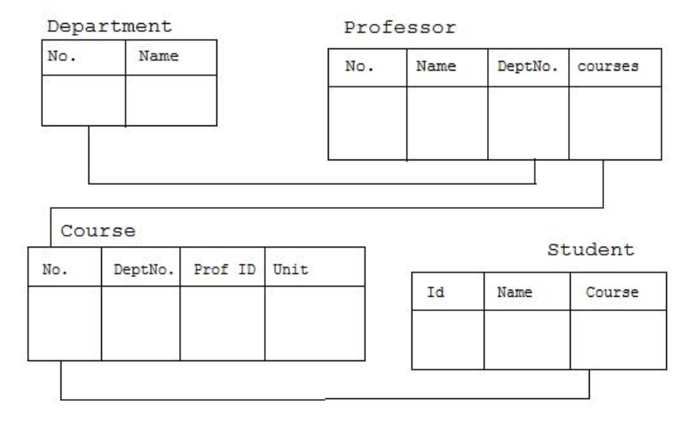

Slide 23
Relational Model was proposed by E.F. Codd to model data in the form of relations or tables. After designing the conceptual model of Database using ER diagram, we need to convert the conceptual model in the relational model which can be implemented using any RDMBS languages like Oracle SQL, MySQL etc. So we will see what Relational Model is.

Slide 24
What is Relational Model?
Relational Model represents how data is stored in Relational Databases. A relational database stores data in the form of relations (tables). Consider a relation STUDENT with attributes ROLL_NO, NAME, ADDRESS, PHONE and AGE shown in Table 1.

Slide 25
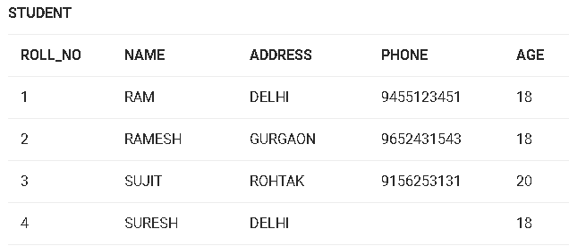

Slide 26
IMPORTANT TERMINOLOGIES
Attribute: Attributes are the properties that define a relation. e.g.; ROLL_NO, NAME
Relation Schema: A relation schema represents name of the relation with its attributes. e.g.; STUDENT (ROLL_NO, NAME, ADDRESS, PHONE and AGE) is relation schema for STUDENT. If a schema has more than 1 relation, it is called Relational Schema.
Tuple: Each row in the relation is known as tuple. The above relation contains 4 tuples, one of which is shown as:
1 RAM DELHI 945512345118
Relation Instance: The set of tuples of a relation at a particular instance of time is called as relation instance. Table 1 shows the relation instance of STUDENT at a particular time. It can change whenever there is insertion, deletion or updating in the database.

Slide 27
Degree: The number of attributes in the relation is known as degree of the relation. The STUDENT relation defined above has degree 5.
Cardinality: The number of tuples in a relation is known as cardinality. The STUDENT relation defined above has cardinality 4.
Column: Column represents the set of values for a particular attribute. The column ROLL_NO is extracted from relation STUDENT.
NULL Values: The value which is not known or unavailable is called NULL value. It is represented by blank space. e.g.; PHONE of STUDENT having ROLL_NO 4 is NULL.

Slide 28
Object-Oriented Data Model
The real-world problems are more closely represented through the object-oriented data model. In this model, both the data and relationship are present in a single structure known as an object. We can store audio, video, images, etc. in the database which was not possible in the relational model(although you can store audio and video in relational database, it is advised not to store in the relational database). In this model, two are more objects are connected through links. We use this link to relate one object to other objects. This can be understood by the example given below.

Slide 29
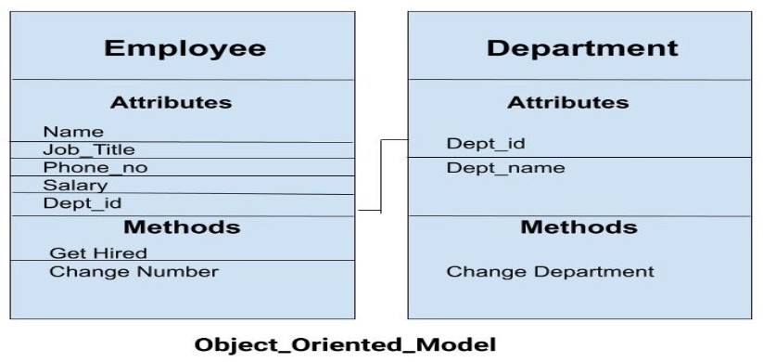
Object-Oriented Data Model
In the above example, we have two objects Employee and Department. All the data and relationships of each object are contained as a single unit. The attributes like Name, Job title of the employee and the methods which will be performed by that object are stored as a single object. The two objects are connected through a common attribute i.e. the Department_id and the communication between these two will be done with the help of this common id.

Slide 30
ANSI/SPARC Architecture
Database architecture uses programming languages to design a particular type of software for businesses and organizations. The Database architecture focuses on the design, development, implementation and maintenance of computer programs that store and organized an information for businesses, agencies and institutions. A database architect develops and implements software to meet the needs of its audience and users.
The Architecture of most of commercial database management system are available today is mostly based on this ANSI-SPARC database architecture
ANSI/SPARC Architecture

Slide 31
ANSI/SPARC Architecture
The objectives of the three-level architecture is to separate the user's view,
It allows independent customized user views: Each user should be able to access the same data, but have a different customized view of the data. These should be independent: changes to one view should not affect others.
It hides the physical storage details from users: Users should not have to deal with physical database storage details.
The database administrator should be able to change the database storage structures without affecting the users’ views.
The internal structure of the database should be unaffected by changes to the physical aspects of the storage: For example, a changeover to a new disk. .

Slide 32
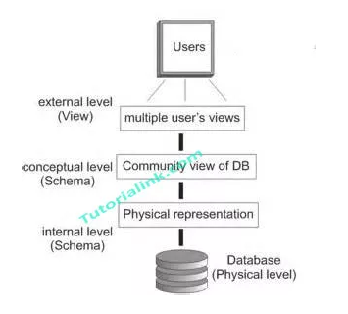
ANSI/SPARC Architecture
Image From Self

Slide 33
Internal level
The lowest level of data abstraction.
The internal level involves how the database is physically represented on the computer system.
It describes how the data is actually stored in the database and on the computer hardware.
It is also known as physical level.
It is a internal view of physical storage of data.

Slide 34
Conceptual level
It describes What or how data are stored in the database and What relationships exist among those data.
The conceptual schema describes the structure of the whole database.
It is also known as Logical level.
The conceptual level is a way of describing what data is stored within the whole database and how the data is inter-related. The conceptual level does not specify how the data is physically stored. Some important facts about this level are:

Slide 35
DBA works at this level.
Describes the structure of all users.
Only DBA can define this level.
Global view of database.
Independent of hardware and software.
Database administrator and designers work at this level to determine What or how data to keep in database. Application developers also work in this level .

Slide 36
External level
It is a highest level of data abstraction.
A user's view of the database describes a part of the database that is relevant to a particular user.
It excludes irrelevant data as well as data which the user is not authorized to access.
It describes only one part of the entire database that a end user concern.
It is also known as an view level.
End users need to access only part of the database rather than entire database.
Different user need different views of database. And so, there can be many view level abstractions of the same database.

Slide 37
Components Of DBMS
There are five major components in the database system environment and their interrelationship is.
Hardware
Software
Data
Users
Procedures

Slide 38
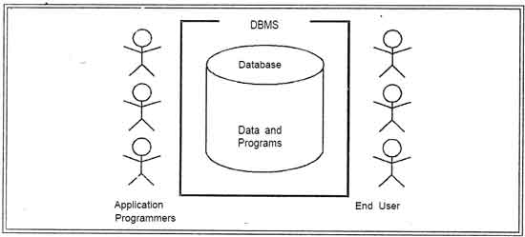
Components Of DBMS
Image From Self

Slide 39
Components Of DBMS
1. Hardware:
The hardware is the actual computer system used for keeping and accessing the data in database.
Conventional database management system hardware consists of secondary storage devices, usually hard disks, on which the database physically resides, together with the associated Input-Output devices, device controllers and· so forth.
Databases run on some range of machines, from Microcomputers to large mainframes computer.
Other hardware issues for a database management system includes database machines, which is hardware designed specifically to support a database system.

Slide 40
Components Of DBMS
2. Software:
The software is the actual database management system. Within the physical databases itself (i.e. the data actually stored) and the users of the system is a layer of software, usually called the DBMS.
All requests from users for access to the database are handled by the database management system. One general function provided by the database management system is thus the shielding of database users from complex hardware-level detail.
The database management system allows the users to communicate with the database. In a sense, it is the mediator within the database and the users.

Slide 41
Components Of DBMS
3. Data:
It is the most important component of database management system environment from the end users point of view.
As shown in observes that data acts as a bridge within the machine components and the user components. The database contained the operational data and the meta-data, the 'data about data'.
The database should be contain all the data needed by the a organization. One of the major features of data in databases is that the actual data are separated from the programs that use the data.
A database should always be designed, built and populated for a particular audience, user and for a specific purpose.

Slide 42
Components Of DBMS
4. Users:
There are a number of users who can access or retrieve data on the demand using the applications and interfaces provided by the database management system.
Each type of user needs different type of software capabilities. The users of a database system can be classified in the following groups, depending on their degrees of expertise or the mode of their interactions with the database management system. The users can be:
Parametric End Users
End Users
Application Programmers
Sophisticated Users
Data Base Administrator

Slide 43
Components Of DBMS
Naïve/Parametric Users : Naive Users are those users who must need not be aware of the presence of the database system or any other system supporting their usage. Naive users are end users of the database who work with a menu driven application program, where the type and range of response is always indicated to the audience or user .
A full user of an Automatic Teller Machine falls in this category. The one by one user is instructed through each step of a transaction. Then responds by pressing a coded key. The operations that can be performed by valve users are very limited and affect only a precise portion of the data in database. For example, in the case of the user of the ATM, user's action affects only one or more of his/her own accounts.

Slide 44
Components Of DBMS
End Users: End users are those who may communicated with the database directly via an online terminal. These users are aware of the presence of the data in database system and may have acquired a certain amount of expertise with in the limited interaction permitted with a data in database.
Sophisticated Users: Such users in database interact with the system without, writing programs.
Instead, they form their requests in database. Each such query is submitted to a very processor whose function is to breakdown data manipulation language statement into instructions that the storage manager understands.

Slide 45
Components Of DBMS
Specialized Users: Such users are those, who write specialized in data in database application that do not fit into the fractional data-processing framework. For example: CAD systems, knowledge base and expert system, systems that store data with complex data types (for example, graphics data and audio data).
Application Programmers: Professional programmers are those who are responsible for developing application programs and user interface. The application programs could be written using the commands available to manipulate a database.

Slide 46
Components Of DBMS
Database Administrator: The database administrator is the person or group in charge for implementing the database system ,within an organization. Database administrator has all the system privileges allowed by the DBMS and can assign and revoke levels of access to and from other users. database administrator is also responsible for the evaluation, selection and implementation of database management system package.

Slide 47
Parallel Database
Introduction to Parallel Databases
Companies need to handle huge amount of data with high data transfer rate.
The client server and centralized system is not much efficient.
The need to improve the efficiency gave birth to the concept of Parallel Databases.
Parallel database system improves performance of data processing using multiple resources in parallel, like multiple CPU and disks are used parallely.
It also performs many parallelization operations like, data loading and query processing.

Slide 48
Goals Of Parallel Databases
Improve performance: The performance of the system can be improved by connecting multiple CPU and disks in parallel. Many small processors can also be connected in parallel.
Improve availability of data: Data can be copied to multiple locations to improve the availability of data. For example: if a module contains a relation (table in database) which is unavailable then it is important to make it available from another module.
Improve reliability: Reliability of system is improved with completeness, accuracy and availability of data.

Slide 49
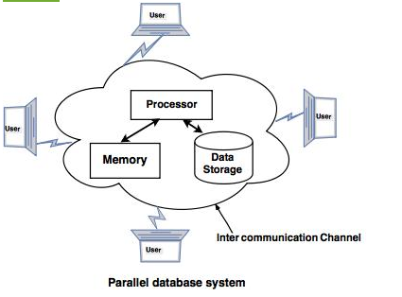
Goals Of Parallel Databases
4. Provide distributed access of data: Companies having many branches in multiple cities can access data with the help of parallel database system.

Slide 50
Parameters of Parallel Databases
Some parameters to judge the performance of Parallel Databases are: 1. Response time: It is the time taken to complete a single task for given time. 2. Speed up in Parallel database: Speed up is the process of increasing degree of (resources) parallelism to complete a running task in less time.
The time required for running task is inversely proportional to number of resources.

Slide 51
Distributed Databases
Distributed database is a system in which storage devices are not connected to a common processing unit.
Database is controlled by Distributed Database Management System and data may be stored at the same location or spread over the interconnected network. It is a loosely coupled system.
Shared nothing architecture is used in distributed databases.

Slide 52
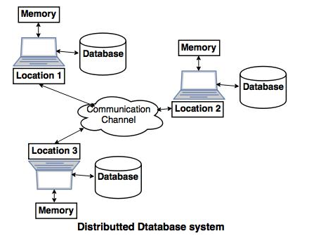

Slide 53
The above diagram is a typical example of distributed database system, in which communication channel is used to communicate with the different locations and every system has its own memory and database.

Slide 54
Goals of Distributed Database system.
Reliability: In distributed database system, if one system fails down or stops working for some time another system can complete the task. Availability: In distributed database system reliability can be achieved even if sever fails down. Another system is available to serve the client request. Performance: Performance can be achieved by distributing database over different locations. So the databases are available to every location which is easy to maintain.

Slide 55
Types of distributed databases.
1. Homogeneous distributed databases system:Homogeneous distributed database system is a network of two or more databases (With same type of DBMS software) which can be stored on one or more machines.
So, in this system data can be accessed and modified simultaneously on several databases in the network. Homogeneous distributed system are easy to handle.
Example: Consider that we have three departments using Oracle-9i for DBMS. If some changes are made in one department then, it would update the other department also.

Slide 56
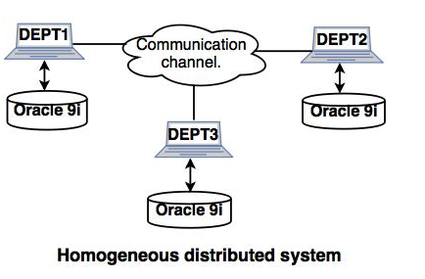

Slide 57
Heterogeneous distributed database system.
Heterogeneous distributed database system is a network of two or more databases with different types of DBMS software, which can be stored on one or more machines.
In this system data can be accessible to several databases in the network with the help of generic connectivity (ODBC and JDBC).
Example: In the following diagram, different DBMS software are accessible to each other using ODBC and JDBC.

Slide 58
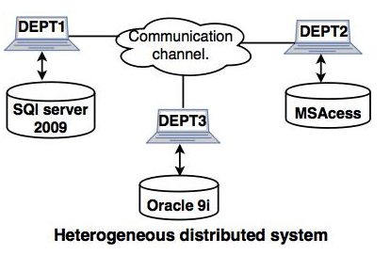

Slide 59
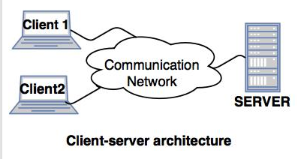
The basic types of distributed DBMS are as follows:
1. Client-server architecture of Distributed system.
A client server architecture has a number of clients and a few servers connected in a network.
A client sends a query to one of the servers. The earliest available server solves it and replies.
A Client-server architecture is simple to implement and execute due to centralized server system.

Slide 60
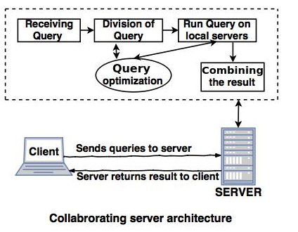
2. Collaborating server architecture.
Collaborating server architecture is designed to run a single query on multiple servers. Servers break single query into multiple small queries and the result is sent to the client. Collaborating server architecture has a collection of database servers. Each server is capable for executing the current transactions across the databases.

Slide 61
Middleware architecture.
Middleware architectures are designed in such a way that single query is executed on multiple servers.
This system needs only one server which is capable of managing queries and transactions from multiple servers.
Middleware architecture uses local servers to handle local queries and transactions.
The software's are used for execution of queries and transactions across one or more independent database servers, this type of software is called as middleware.

Slide 62
Object – Oriented DBMS
Able to handle many new data types, including graphics, photographs, audio, and video, object-oriented databases represent a significant advance over their other database cousins.
Object-oriented databases use small, reusable chunks of software called objects. The objects themselves are stored in the object-oriented database. Each object consists of two elements:
1) a piece of data (e.g., sound, video, text, or graphics),
2) the instructions, or software programs called methods, for what to do with the data.. The instructions contained within the object are used to do something with the data in the object. For example, test scores would be within the object as would the instructions for calculating average test score

Slide 63
OODBMS is a DBMS which allows information to be represented in the form of objects as used in object-oriented programming.
OODBMSs were developed in 1980s to overcome the limitations in RDMSs such as handling large and complex data. OODBMSs provide an integrated application development environment by joining object-oriented programming with database technology.
OODBMSs enforce object oriented programming concepts such as encapsulation, polymorphism and inheritance as well as database management concepts such as Atomicity, Consistency, Isolation and Durability.

Slide 64
Object-oriented languages such as Java, C#, Visual Basic .NET and C++ can work well with OODBMSs. Since both the programming language and OODBMS use the same object-oriented model, the programmers can maintain the consistency easily between the two environments

Slide 65
In object oriented database, relationships are represented by references via the object identifier (OID).
Object oriented systems employ indexing techniques to locate disk pages that store the object. Therefore, they are able to provide persistent storage for complex-structured objects.
Handles larger and complex data than RDBMS.
The constraints supported by object oriented systems vary from system to system.
In object oriented systems, the data management language is typically incorporated into a programming language such as #C++.
Stores data entries are described as object.
Object oriented database can handle different types of data.
In the object oriented database, the data is stored in the form of objects.

Slide 66
ORDBMS
An object-relational database (ORD), or object-relational database management system (ORDBMS), is a database management system (DBMS) similar to a relational database, but with an object-oriented database model: objects, classes and inheritance are directly supported in database schemas and in the query language.
Object relational database management systems provide a middle ground between relational and object-oriented databases. In an ORDBMS, data is manipulated using queries in a query language. These systems bridge the gap between conceptual data modeling techniques such as entity relationship diagrams and object relational mapping using classes and inheritance. ORDBMSs also support data model extensions with custom data types and methods. This allows developers to raise the abstraction levels at which problem domains are viewed.

Slide 67
ORDBMS
The ORDBMS (like ODBMS or OODBMS) is integrated with an object-oriented programming language.
The characteristic properties of ORDBMS are 1) complex data, 2) type inheritance, and 3) object Behavior.
Complex data creation in most SQL ORDBMSs is based on preliminary schema definition via the user-defined type (UDT).
Type inheritance. That is, a structured type can have subtypes that reuse all of its attributes and contain additional attributes specific to the subtype.
object behavior, is related with access to the program objects. Such program objects must be storable and transportable for database processing, therefore they usually are named as persistent objects. Inside a database, all the relations with a persistent program object are RELATION WITH ITS OBJECT IDENTIFIER

Slide 68
ORDBMS Advantages
Reusable and Sharable.
Ability of applying objects with existing models as it is.
Allows users and programmers to start using object-oriented systems in parallel.
Large storage capacity
Supports rich Data Types
Scalability
Explicit representation of Relationships

Slide 69
ORDBMS Advantages
Support of both navigational and associative access to information.
Improved concurrency.
Support for composite data types.
Improved Integrity.
Database Extensibility
Custom Data Access Methods. Exa: R-Tree indexes..
Built-in complex SQL functions can be provided for data operations. E.g.: aggregating, slicing, subsetting, reprojecting etc…

Slide 70
Object Relational Database Comparison

Slide 71
Introduction
Brief introduction to the 3 main databases:
RDBMS
ODBMS
ORDBMS
Compare the above systems
Summary

Slide 72
Object-Orientation
An OOD supports the following
Abstraction
Encapsulation
Classes & Instances
Inheritance
Messages & Methods
Polymorphism

Slide 73
OODB Features
Object Identity
Locking
Object Access
Dynamic Space Compaction
Navigation

Slide 74
Object-Relational Database
Amalgamation of RDBMS & ODBMS
Adds limited Object-Oriented functions
Data still stored in tables
Supports new types of data (multimedia)

Slide 75
RELATIONAL vs OBJECT-ORIENTED
Good for large amounts of data | Good for storing small amounts of complex data
Good for retrieval of data | Excellent at data manipulation
Table/Record based | Object Based
Relationships expressed in keys | Relationships built in to objects & containers

Slide 76
RELATIONAL vs OBJECT-ORIENTED
Limited complexity of relationships | Complex relationships
Defined types | Variety of data types
Language independence | Often connected to a language
SQL | OQL

Slide 77
Comparison of RDBMS, OODBMS, ORDBMS
Defining standards:
RDBMS - SQL2(ANSI X3H2)
ODBMS - ODMG-v2.0
(support ODL/OQL ODL : Object description language OQL : Object Query Language)
ORDBMS - SQL-3

Slide 78
What is it?
RDBMS: Relational Database management System. It gives better storage, indexing, query processing and optimization technique
OODBMS : Object Oriented Database Management system. It consist of object oriented programming language with some additional features.
ORDBMS: Object Relational Database Management system with additional features

Slide 79
Support for object-oriented programming:
RDBMS - Poor
ODBMS - Direct & extensive
ORDBMS - Limited mostly to new data types

Slide 80
Simplicity of use:
RDBMS - Table structures easy to understand; many end-user tools available
ODBMS - Ok for programmers; some SQL access for end users
ORDBMS - Same as RDBMS, with some confusing extensions

Slide 81
Simplicity of development:
RDBMS - Provides independence of data from app, good for simple relationships
ODBMS - Objects are a natural way to model; can accommodate various relationships
ORDBMS - Provides independence of data from app, good for simple relationships

Slide 82
Product Maturity:
RDBMS - Very mature. Well established.
ODBMS – Relatively mature.
ORDBMS – Immature; extensions are new, still being defined & are relatively unproven.

Slide 83
Integration with programming language:
RDBMS - It provides better features as compared to traditional DBMS
ODBMS – It aims to achieve seamless integration with programming language.
ORDBMS – It do not aim integration with programming language..

Slide 84
Query Facilities:
RDBMS – The query facility are of at most important.
ODBMS – The query facility of OQL are not supported efficiently .
ORDBMS – The query facility are at most important

Slide 85
Transaction:
RDBMS – Transaction take shorter duration of time.
ODBMS – Transaction takes longer duration of time.
ORDBMS – Transaction takes shorter duration of time

